Slide 1
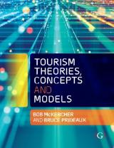

Chapter 5: Access and the Spatial Interactions of Tourists

Slide 2
Learning Objectives
Distinguish between the resource and commodity values of time and analyse how they affect travel patterns
Describe distance decay and analyse how it influences both absolute demand and behaviour of tourists
Define the Effective Tourism Exclusion Zone and analyse its impact on tourism flows
Evaluate segment transformation and the impact of distance on behaviour
Define market access and assess how it influences tourist behaviour
Explain different itinerary models

Slide 3
Access and attractions are critical features of tourism
Attractions drive tourism
Access, or the ability of visitors to get to and travel within a destination, plays a key role in its success
If tourists cannot get to a destination, then they cannot experience the attractions therein
If they cannot move around the destination easily, their actions will be constrained

Slide 4
Time
The only absolute in tourism
Cannot be saved, only spent
Constrains or expands the number and range of potential activities available and the depth at which individual activities can be experienced
From the perspective of tourist movements, time expenditure usually involves some trade-off between time spent in transit and time spent in the destination or at desired attractions.
2 ways time can be considered:
  Commodity
  Resource

Slide 5
2 approaches to travel time
Commodity Value
The act of travelling has value/utility in itself
Getting there is part of the enjoyment of the trip
Willing to trade time at destination for travel
Resource Value
(opportunity / cost)
Need to allocate time for the best benefit at the least cost
‘Cost’ of travel
  Time spent travelling means less time spent in the destination
Will seek to minimise travel time unless the value of longer travel time exceeds the opportunity cost

Slide 6
Differences between commodity and resource valuation of time
 | Commodity | Resource
Value of time | Opportunity | Cost
Transit time | Has value in and of itself | Has little value and needs to be minimized
Type of tourist | Process oriented | Goal oriented
Amount of time available | Much | Little
Trade-off | Time spent getting to the destination means less time at the destination | Time spent at the destination at the cost of time spent travelling
Typical trip | Long haul Multiple destination Touring | Short haul Single destination

Slide 7
Distance decay
Tobler’s (1970: 236) First Law of Geography states that “everything is related to everything else, but near things are more related than distant things.”
Demand for tourism varies inversely with the distance travelled or with an increase in time or money costs.
  The further one travels from the point of origin, the less demand there will be for tourism products.

Slide 8
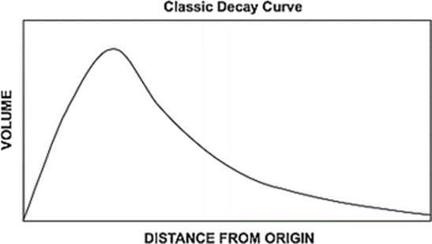
Distance decay
Demand peaks at some relatively close distance to the origin and then declines exponentially as distance increases
Distance is not a deterministic factor, BUT it is a valid proxy variable that reflects the cumulative impact of:
    Time availability
    Cost considerations
    Preferred transport mode
    Travel budget
    The likely willingness or ability to engage with different cultures
    Other factors

Slide 9
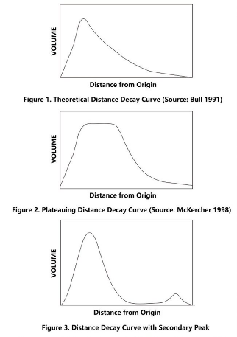
3 types of decay curves evident
Classic curve – demand peaks and then declines exponentially
Plateau curve – demand peaks and plateaus due to limited capacity of destinations before declining
Secondary peak some distance from source market

Slide 10
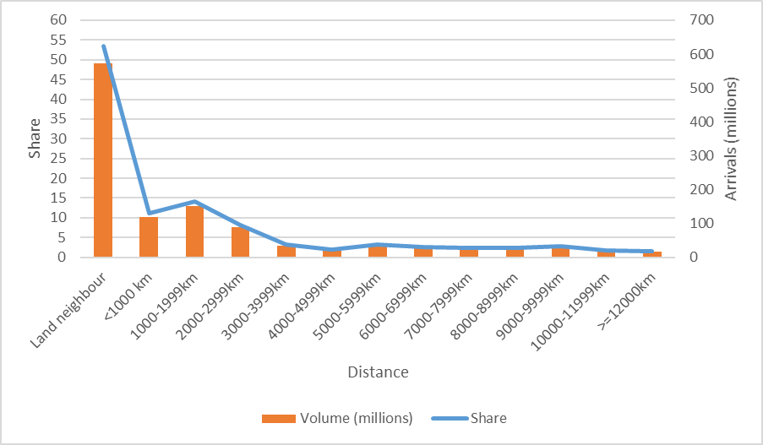
Global tourism flows 2016
More than half of all international tourism is to land neighbours
¾ to destinations within 2000km of land border
Share of departures for travel greater than 5000 km was typically 3% or lower

Slide 11
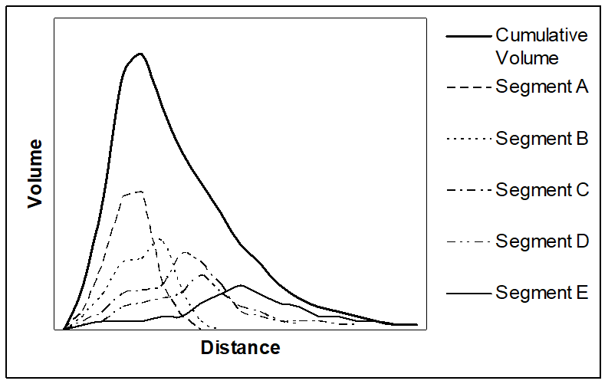
Who is more affected more by the decaying impact of distance?
People with:
  Lower incomes and lower discretionary incomes
    Cost of travel increases with distance
  Less time (less vacation allocation)
    Generally want to maximize time spent at the destination and choose nearby places
  Larger travel parties
    Higher transport and accommodation costs
  People who are nervous about entering culturally different places
    High cultural distance can intimidate some people
  Reason to travel
    Short distance travel can satisfy needs for pleasure, escape or to spend time with family
    Long haul travel may be more suitable to if the goal is self development or to achieve a lifetime goal
Notes:
Each of these factors may play a role in determining if someone is likely to restrict travel to short distances from home, or to travel long distances.
Have a discussion with your class.
Party size example – a family of 4 can get in a car and drive 6 hours to a destination, but airfare for a family of 4 to fly 6 hours from home is usually quite expensive!
Plog says come people like familiarity while other s seek strangeness. Those who do not to go to unfamiliar places are likely to stay closer to home, while those who like to explore, may travel further.

Slide 12
Prof Sara Dolnicar talks about segmenting tourist markets
https://www.youtube.com/watch?v=xkj2-ibu7aQ

Slide 13
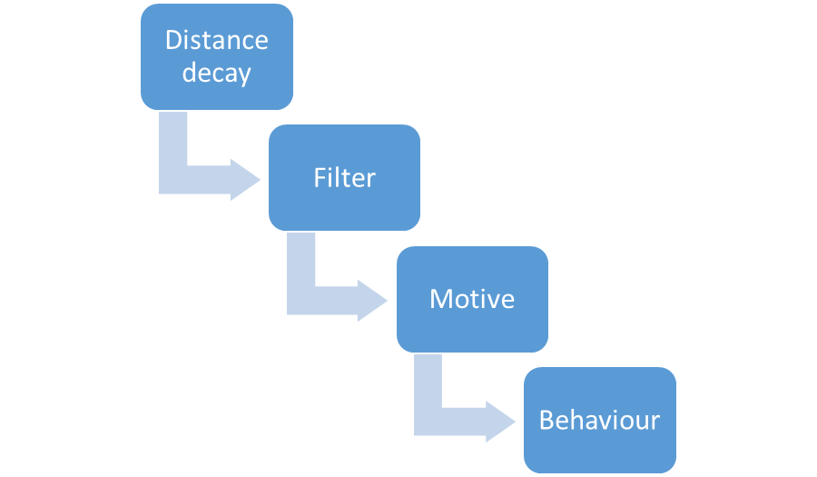
Consumer behaviour changes
Distance influences who can travel
In turn reflects different motive
  Short haul, common, hedonism, escape, rest, relaxation and spending time with family
  Long haul, aspirational, rare, often once-in-a-lifetime occurrence
In turn affects behaviour
  Short haul - shopping, dining, sightseeing, theme parks
  Long haul - explore the cultural features of a destination

Slide 14
Prof Bob McKercher talks about the impact of distance on tourism demand and tourist behaviour
https://www.youtube.com/watch?v=X__RJfofy_w

Slide 15
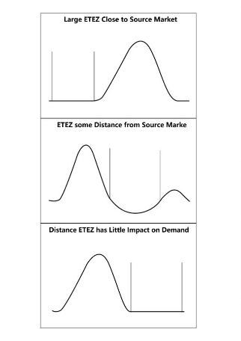
Effective Tourism Exclusion Zones (ETEZ)
Zone where little tourism activity occurs distorts the decay curve
ETEZ close to source market - shift decay curve outward
  Common with island source markets
ETEZ located some distance from the source market will lead to secondary peak
Distant ETEZ will have no impact

Slide 16
ETEZ sets boundary between long and short haul travel
Within inner boundary of ETEZ
Beyond outer boundary of ETEZ
Trips typified by short break, short duration, repeat pleasure trips
Single destination trips
Popularity of package tours
Typified by longer duration trips
Independent travel
Multi-destination trips

Slide 17
Market access
Relative term that considers the number of intervening opportunities one must pass before reaching a desired destination
Assumption that tourists are rational consumers and will travel to proximate destinations if their needs can be met
Measured by the relative difference in the time, cost, distance, or effort required to access different destinations

Slide 18
Differences between distance decay and market access
Distance decay asks “how far do I want to travel?”, while market access asks “how many destinations must the prospective consumer pass before reaching the desired one?”
Distance decay examines aggregate tourism flows, market access if product or tourism type specific
Distance decay is absolute where market access is relative
  A ski resort 500 km away may have strong market access if it is closest to the source market
  A beach 50 km away may have weak market access is people have to pass by many other beaches

Slide 19
Modifying market access
Creating new opportunities closer to source markets, thus adversely affecting the market access of previously proximate destinations
Removing artificial or political barriers to entry, by relaxing visa conditions
Changing travel time, for example the advent of low-cost carriers has fundamentally transformed Spain’s tourism sector
Changing speed, with the development of the high-speed rail network in China increasing visitor arrivals by at least 10%
Changing effort, through the development of ski lifts resulting in the broadening of the market

Slide 20
Itinerary models
4 basic types of itineraries
Single destination, there-and-back trip that may or may not include side trips
Transit leg to the destination area, followed by a circle tour, stopping overnight at different places 
Circle tour with or without multiple access and egress points
Hub and spoke itineraries may be evident where tourists base themselves in a destination area and take side trips to other destinations

